Slide 1

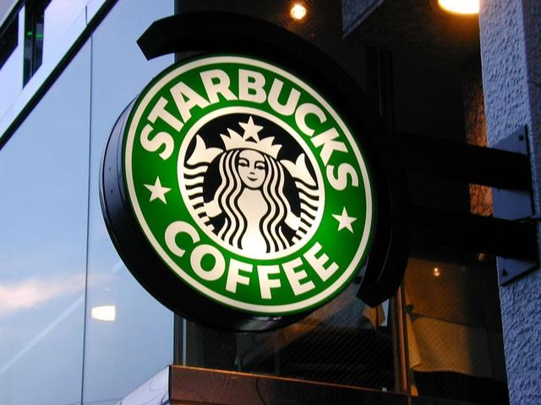
Starbucks Analysis
Presented by: Steven Ho

Slide 2
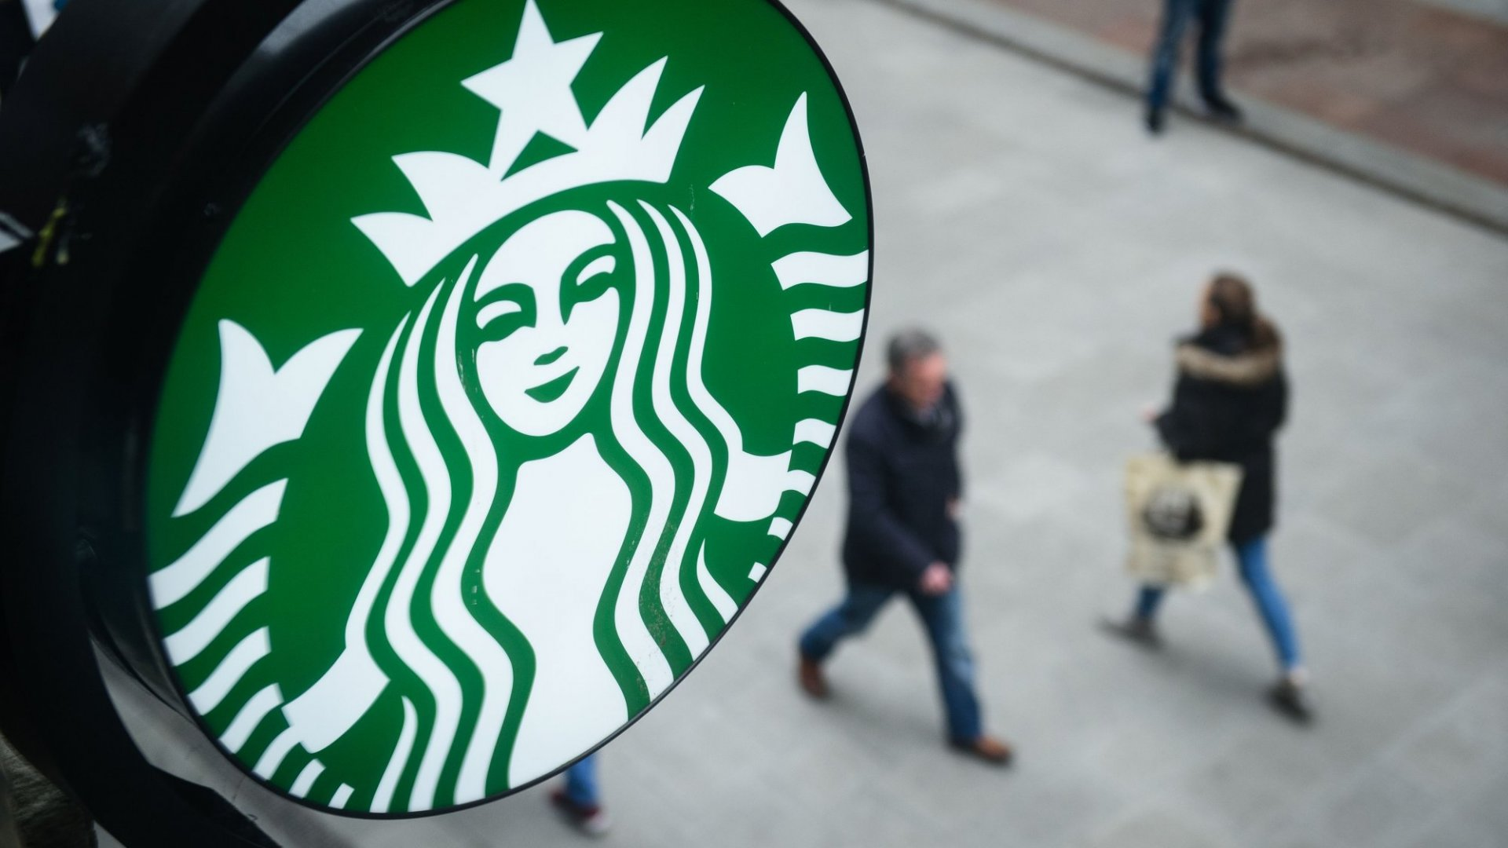
Agenda
01
Starbucks Background
02
Problem Statement
03
Drinks to Stay Away From
04
Drinks to Choose!
05
Analysis
06
Conclusion

Slide 3
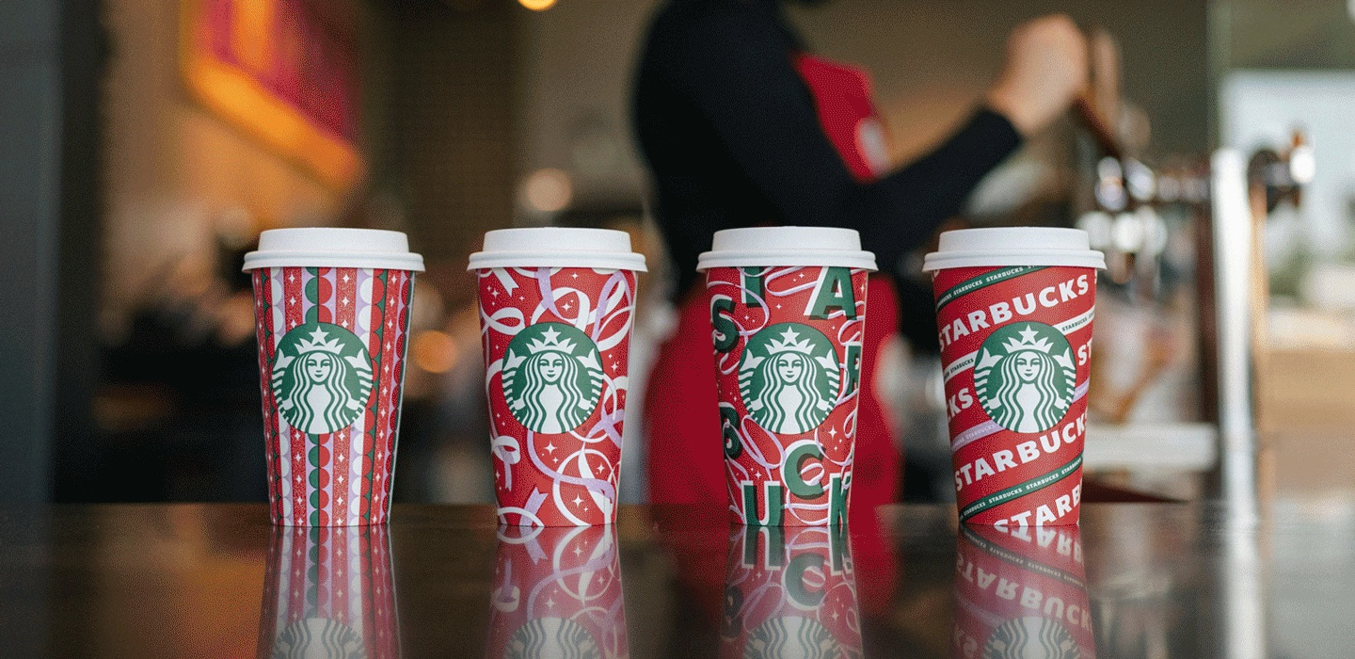
The Truth about Starbucks Beverages
What is actually in a Starbucks Beverage? When is the last time you ever asked about Nutritional Facts while ordering your daily coffee?

Slide 4

Background
Starbucks coffee shop first opened its doors in Seattle, WA by three students on March 30, 1971 and it has become the biggest coffee chain in the world. Starbucks has over 31,000 stores, including Starbucks Reserve stores and pickup-only stores. It seems like there is Starbucks on almost every corner in every City, no matter how big or small. Starbucks has really given themselves as a Coffee “Hot Spot” for all ages and at all seasons. Starbucks has been able to adapt to the people’s wants and needs by offering seasonal drinks as well as the ability to customize ANY drink the customer may like. That can include, additives such as: Syrups, creamers, toppings, etc. There are plenty of competitors in the Industry, but one thing Starbucks leads in is the functionality of customization.

Slide 5
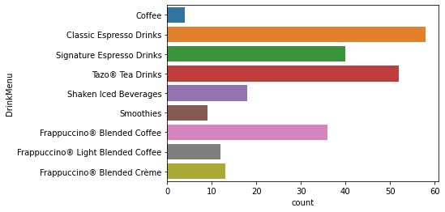
Calories Analysis
The first attribute that most people see in larger and bolded font when looking at the Nutritional Facts are the Calories
To the left, we can see the count of Calories that are in Starbucks Beverages
Here, we can notice that Classic Espresso Drinks and Tazo Tea Drinks have the highest calories with both 50+ calories per serving!

Slide 6
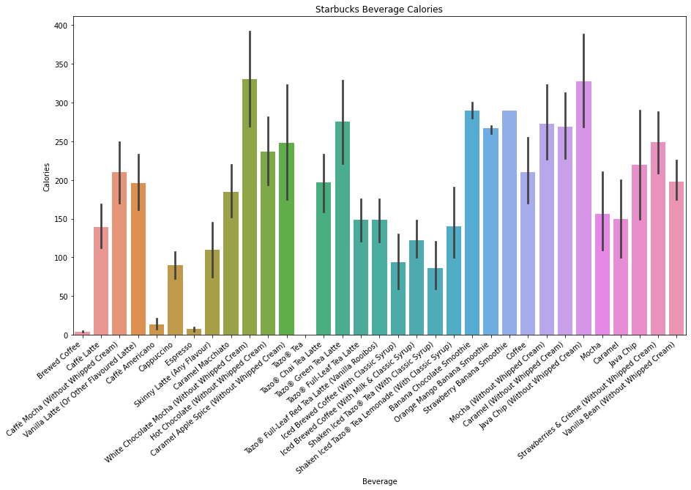
Calories Analysis
To dive deeper into the Caloric intake of Starbucks Beverages, per the bar plot to the left, we can analyze that White Chocolate Mocha & Java Chip Drinks have the highest Calories

Slide 7
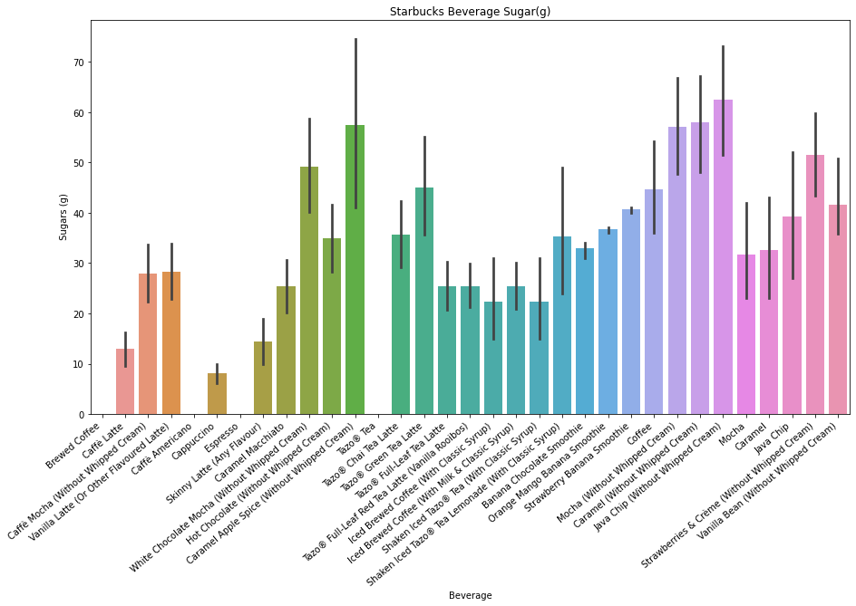
Sugar Intake Analysis
Sugar is another substantial Nutritional fact that most people observe
Per the bar plot to the right, we can notice that Caramel Apple Spice & Java Chip have the highest Sugar intakes
Note that now Java Chip has the highest Calories and Sugar intake… coincidence?

Slide 8
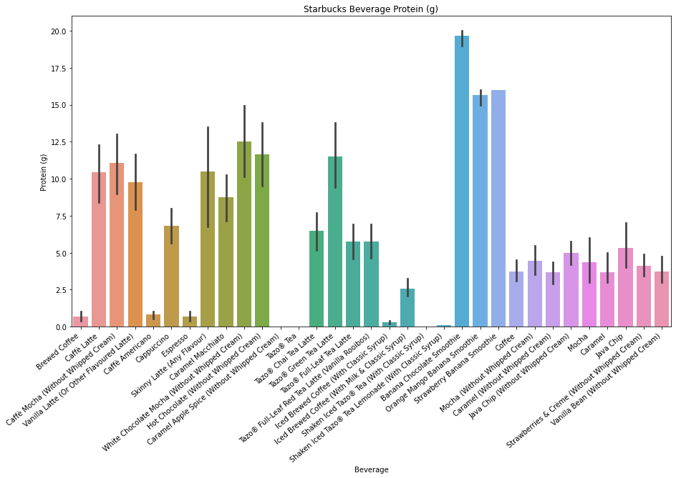
Protein Analysis
Protein is a very large component for customers who are looking for a fun and refreshing drink, but also need that extra protein nutrition if that means they are coming from the gym or just to live a healthy lifestyle
The Smoothies lead the category here with the Banana Chocolate & Orange Mango Smoothie (YUM!)

Slide 9
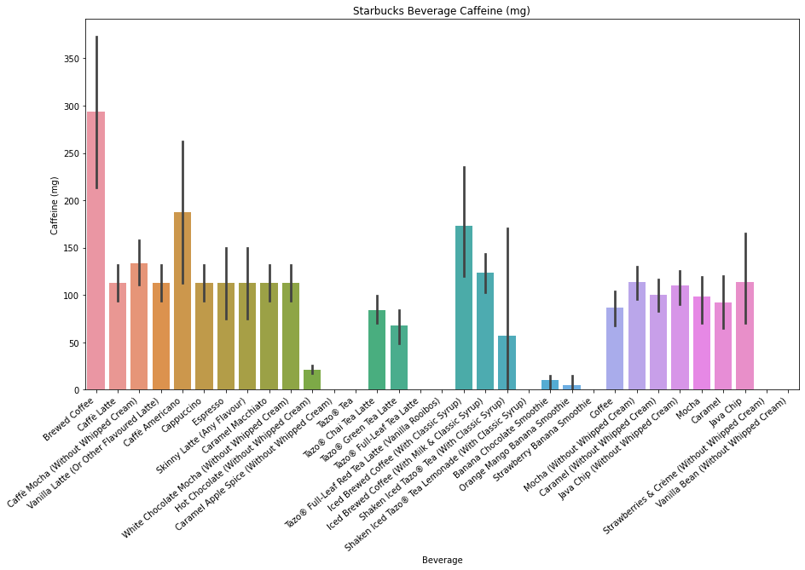
Caffeine Analysis
We’re drinking Coffee, right?
Half the time I am in a Starbucks, I sometimes forget they even sell Coffee due to the variety of drinks they offer
No surprise here, but looks like the Brewed Coffee and Caffe Americano lead the group in Caffeine intake

Slide 10
Conclusion
No matter what type of drink you’re looking for, Starbucks offers such a large variety that any customer can find the correct drink, but it’s always helpful to know what Nutritional facts belong to what type of drink
If you have a sweet tooth and don’t mind the extra Calories & Sugar, I would recommend the Mocha or Java Chip Drinks
If you are going for a study session or just got out of the gym and want to stay on the more health conscious side, resort to the Smoothie or original Coffee selections without additive Sugars/syrups

Slide 11

Thank you!

